Slide 1
UI Design
Summer Camp 2016
Sul Ki Park Department of Computer Science Software Engineering Laboratory (SELAB) Soongsil University psk9314@gmail.com

Slide 2
UI Layout & Navigation

Slide 3
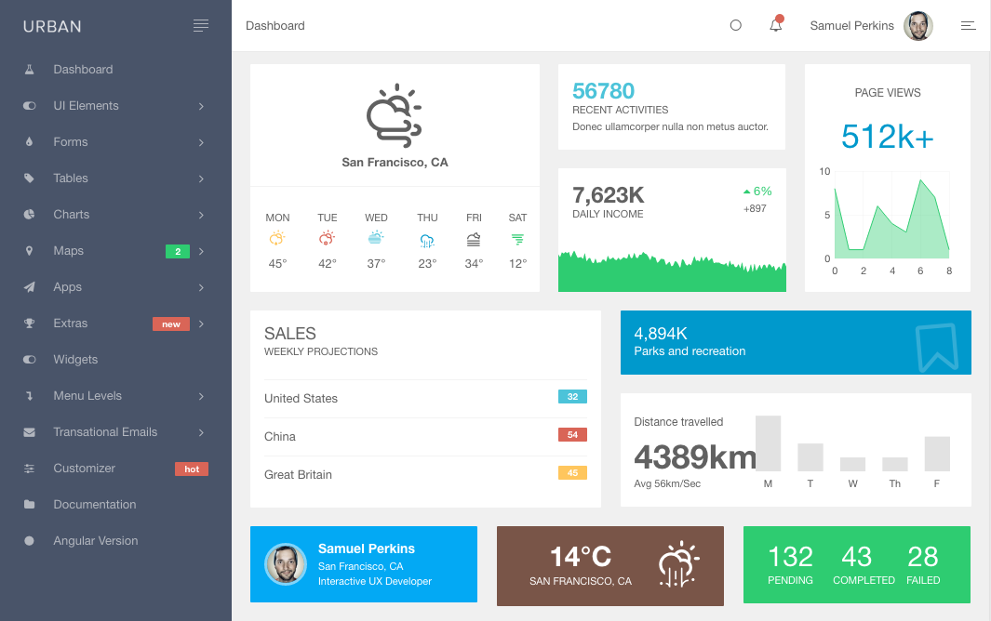
UI Layout Reference

Slide 4
Main Color Scheme
#FFFFFF
#03A9F4
#F0F0F0
#2ECC71
#495469
#FFC65D
#795548
#D96557

Slide 5
UI Navigation
Main Page
Stress Most Recent
B.Age Most Recent
Recent week
Recent week
Recent Month
Recent Month
Recent Year
Recent Year

Slide 6
UI Pages

Slide 7

Login Page
Health Indicator Service
ID
PW
Login
Sign up
2016 Software Engineering Laboratory

Slide 8
Dropdown Menu
Health Indicator Service
Stress
Biological Age
Mr. Lee
Most Recent
Recent week
Recent month
Recent year
Most Recent
Recent week
Recent month
Recent year
2016 Software Engineering Laboratory

Slide 9
User Profile Register
Health Indicator Service
Stress
Biological Age
Mr. Lee
User Profile Register
Heap
Waist
Submit
2016 Software Engineering Laboratory

Slide 10
Login FlowChart
Login Button
o
x
Check Rainbow
Login
o
x
Modal
Alert “Id/Password Do Not Exist in Rainbow”
o
x
Login
x

Slide 11
Most Recent Stress
Health Indicator Service
Stress
Biological Age
Mr. Lee
Most Recent Stress
5/10
Not Bad
Show All
GSR
EEG
Pulse
2016 Software Engineering Laboratory

Slide 12
Recent Week Stress
Health Indicator Service
Stress
Biological Age
Mr. Lee
Recent Week Stress
Show All
GSR
EEG
Pulse
2016 Software Engineering Laboratory

Slide 13
Recent Month Stress
Health Indicator Service
Stress
Biological Age
Mr. Lee
Recent Month Stress
Show All
GSR
EEG
Pulse
2016 Software Engineering Laboratorv

Slide 14
Recent Year Stress
Health Indicator Service
Stress
Biological Age
Mr. Lee
Recent Year Stress
Show All
GSR
EEG
Pulse
2016 Software Engineering Laboratory

Slide 15
Most Recent B.Age
Health Indicator Service
Stress
Biological Age
Mr. Lee
Most Recent Biological Age
Show All
BMI
Weight
Pulse
Blood Pressure
2016 Software Engineering Laboratory

Slide 16
Recent Week B.Age
Health Indicator Service
Stress
Biological Age
Mr. Lee
Recent Week Biological Age
Show All
BMI
Weight
Pulse
Blood Pressure
2016 Software Engineering Laboratory

Slide 17
Recent Month B.Age
Health Indicator Service
Stress
Biological Age
Mr. Lee
Recent Month Biological Age
Show All
BMI
Weight
Pulse
Blood Pressure
2016 Software Engineering Laboratory

Slide 18
Recent Year B.Age
Health Indicator Service
Stress
Biological Age
Mr. Lee
Recent Year Biological Age
Show All
BMI
Weight
Pulse
Blood Pressure
2016 Software Engineering Laboratory

Slide 19
Thank You !

